Slide 1

Web Application Development
COMP-229

Slide 2
What is React
Meta Platforms created React for building user interfaces (UI).
React is a JavaScript library, not a framework.
It focuses mainly on the view layer of applications.
React applications are built using components.
React is commonly compared with:
  Angular
  Vue.js
https://react.dev/

Slide 3
create-react-app
Creating a React App
Using Create React App
Create a folder in vscode or create a folder and open it in vscode
At the terminal in your vscode,
To get started with create-react-app, install the package globally with the following command:
Install globally:
npm install -g create-react-app

Slide 4
Create project:
create-react-app my-react-app
Move into project:
cd my-react-app
Start application:
npm start
OR
yarn start.
This will start your application on port 3000.

Slide 5
Important Packages Installed
React
ReactDOM
react-scripts
Features Included Automatically
Babel
Webpack
ESLint

Slide 6
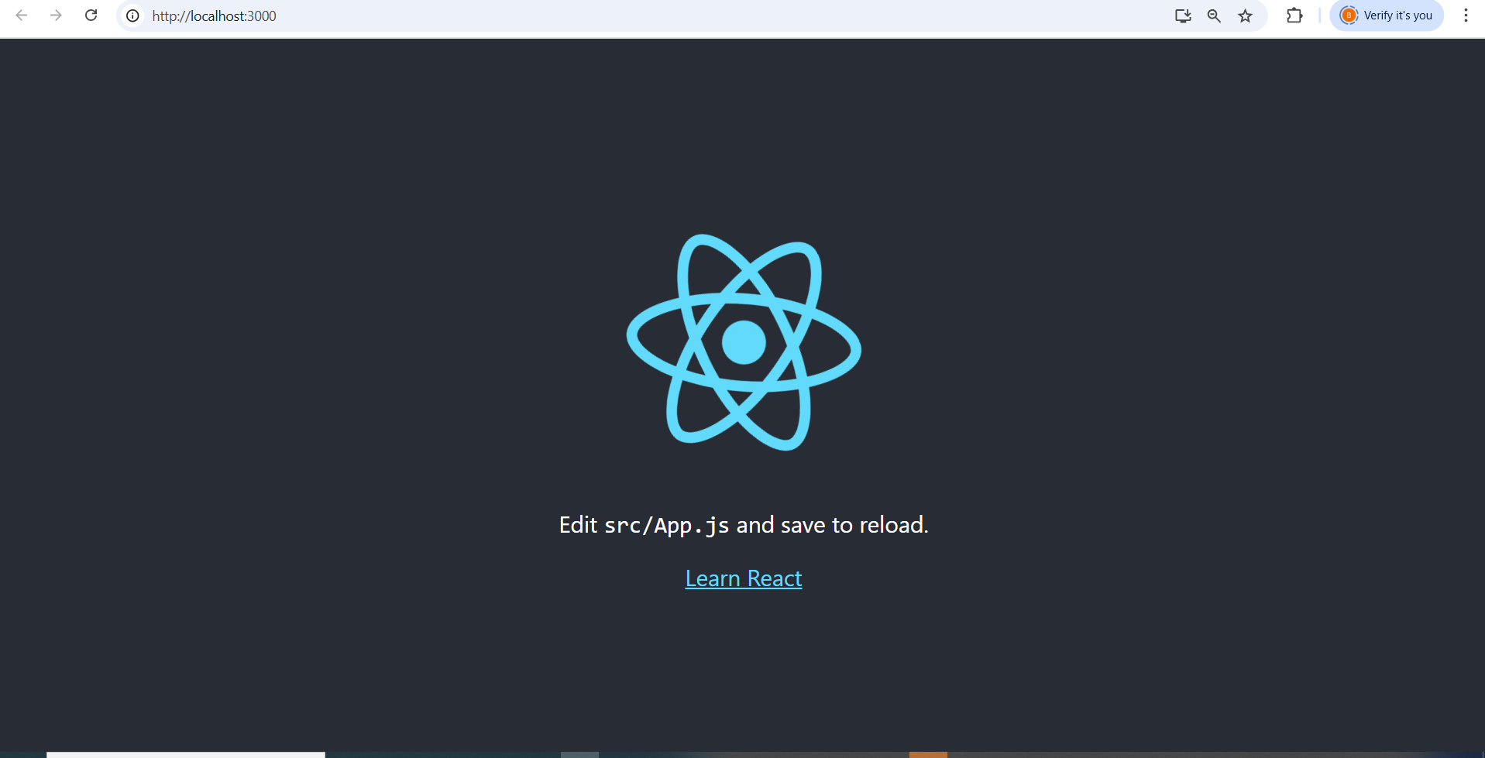

Slide 7
Using Vite
Vite is a faster modern tool for React projects.
Create a folder call WEEK2
❑ For this, you need to have installed npm or yarn.
❑ Open your terminal and write the following command:
yarn create vite app-name --template react # For yarn
npm create vite@latest app-name --template react # For npm
In this case my app-name is client, so I will have:
yarn create vite client --template react # For yarn
npm create vite@latest client --template react # For npm

Slide 8
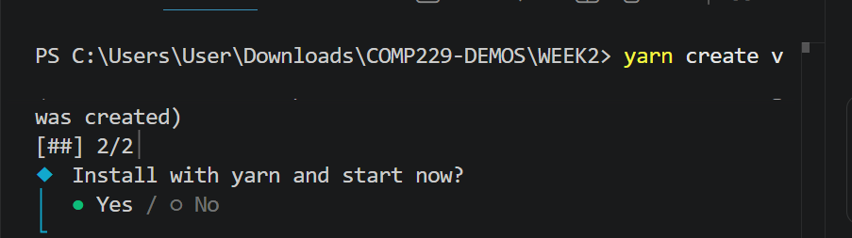
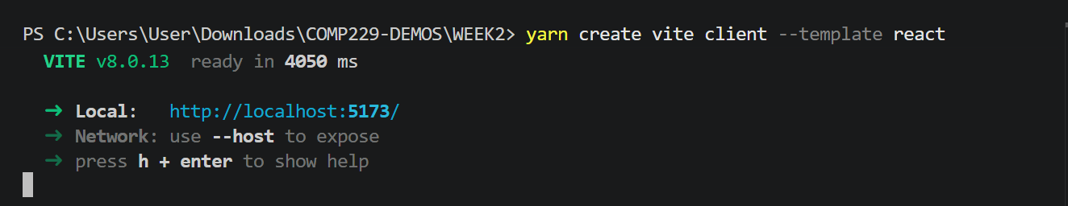
Select Yes
Open the link in the browser or hold down the ctrl key and click on the link.

Slide 9
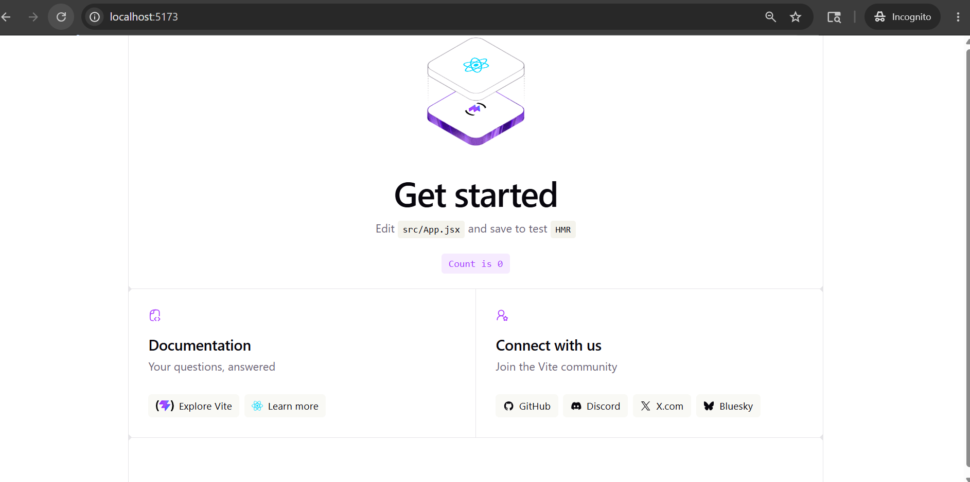

Slide 10
Configuring Vite - Vite Configuration
We’re going to configure vite, open the file vite.config.js
and overwrite its content with the following:
import { defineConfig } from "vite";
import react from "@vitejs/plugin-react";
export default defineConfig({
plugins: [react()],
build: {
manifest: true,
rollupOptions: {
input: "./src/main.jsx",
},
},
});

Slide 11
Configuring Vite contd.
Purpose
Configures React plugin
Sets entry point to src/main.jsx instead of the default index.html

Slide 12
Install dependencies
Enter to the project folder and install the dependencies:
❑ cd client
yarn # For yarn
OR
npm install # For npm
You should have the following folder structure:
Run application
From within the WEEK2 folder, cd client you can run
yarn dev
or
npm run dev.
This will start your application.

Slide 13
Page Setup
Inorder to work with React in the browser, we need to include two libraries:
React and
ReactDOM.
React is the library for creating views.
ReactDOM is the library used to actually render the UI in the browser.
Both libraries are available as scripts from the unpkg CDN.

Slide 14
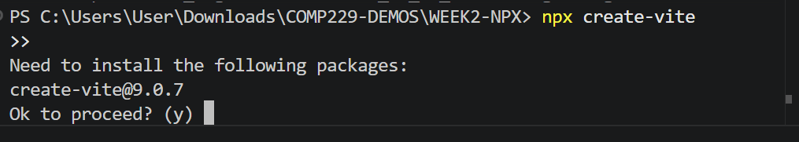
NPX
You can also use npx create-vite to spin up your react application using vite.
If it gives you an error first install it globally using the following command:
npm install –g create-vite
Then;
npx create-vite
Press enter

Slide 15
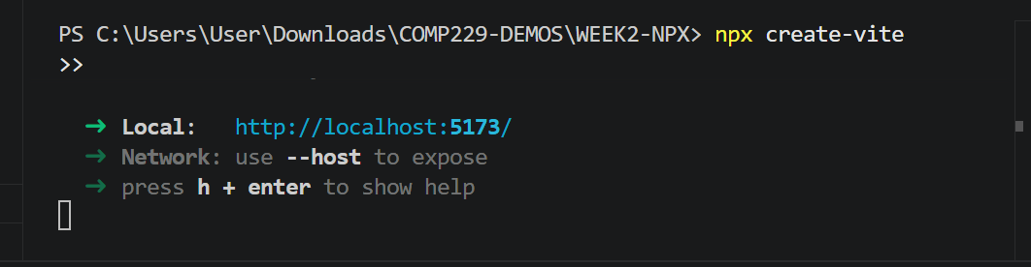
Change the project name to client
Select React
Select JavaScript
Install with npm and start now? Select Yes and press enter

Slide 17
React Features
React has some core features that make it stand out from other JavaScript libraries
Features such as:
Components Based structure
Applications are divided into reusable components.
JSX
Allows writing HTML inside JavaScript.
Virtual DOM
Improves performance by updating only changed parts.
One-way Data Binding
Data flows from parent to child components.

Slide 18
Extensions
Supports:
Redux
Flux
React Native

Slide 19
Types of components in ReactJS
In React, we mainly have two types of components:
Functional Components: Functional components are simply JavaScript functions.
Example
function DemoComponent() {
return (
<h1>Welcome Message!</h1>
);
}

Slide 20
Updated App.jsx
import './App.css'
function Decomponent() {
return (
<div>
<h1>Welcome Message!</h1>;
</div>
);
}
export default Decomponent

Slide 21
Updated main.jsx
import { StrictMode } from "react";
import { createRoot } from "react-dom/client";
import "./index.css";
import Decomponent from "./App.jsx";
createRoot(document.getElementById("root")).
render(
<StrictMode>
<Decomponent />
</StrictMode>
);

Slide 22
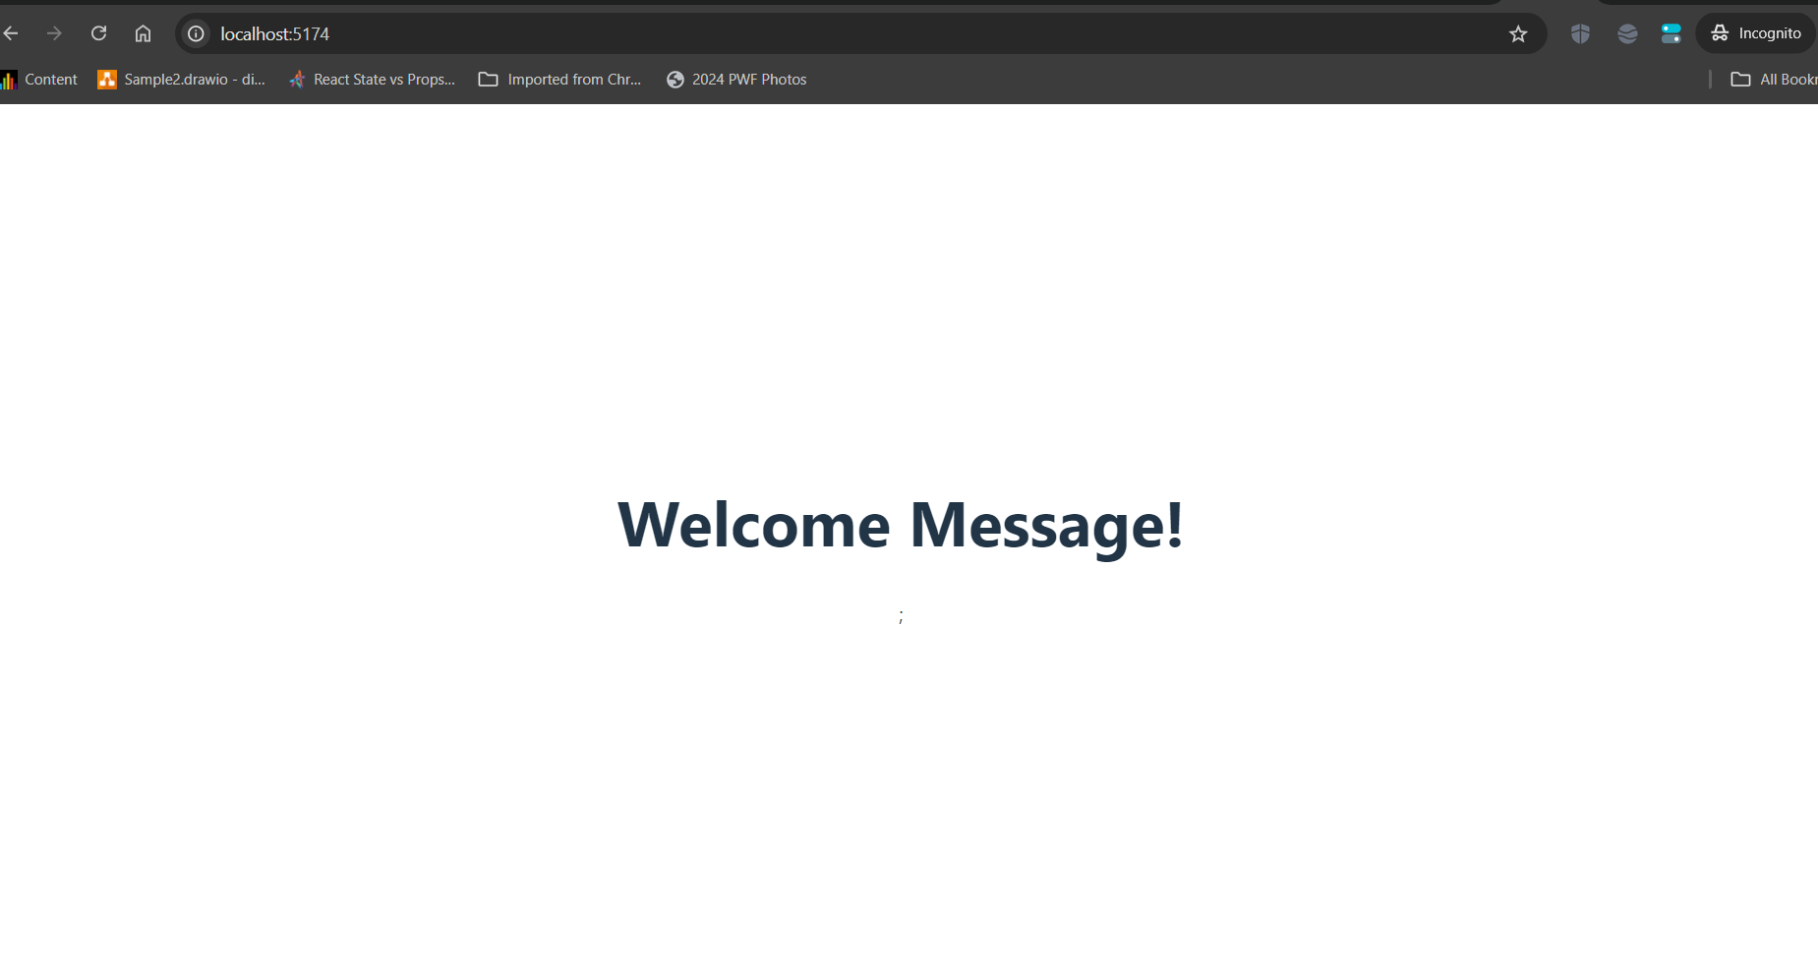

Slide 23
Class Components
Class components use ES6 classes.
Example
class Democomponent extends React.Component {
render() {
return <h1>Welcome Message!</h1>;
}
}

Slide 24
Updated App.jsx
import React from 'react'
import './App.css'
class Democomponent extends React.Component {
render() {
return (
<div>
<h1>Welcome Message!</h1>;
</div>
);
}
}
export default Democomponent

Slide 25
Updated main.jsx
import { StrictMode } from "react";
import { createRoot } from "react-dom/client";
import "./index.css";
import Democomponent from "./App.jsx";
createRoot(document.getElementById("root")).
render(
<StrictMode>
<Democomponent />
</StrictMode>
);

Slide 26
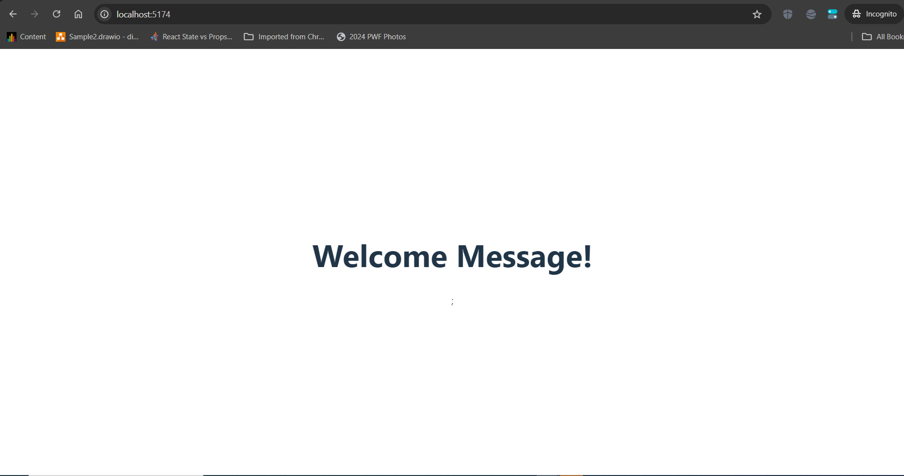

Slide 27
Navigate to the App.jsx file replace the existing code with the following code:

Slide 28
Updated App.jsx
import React from "react";
import "./App.css";
// This is a functional component
const Welcome = () => {
return (
<div>
<h1>Hello World!</h1>;
</div>
);
};
export default Welcome

Slide 29
Updated main.jsx
import { StrictMode } from "react";
import { createRoot } from "react-dom/client";
import "./index.css";
import Welcome from "./App.jsx";
createRoot(document.getElementById("root")).render(
<StrictMode>
<Welcome />
</StrictMode>
);

Slide 30
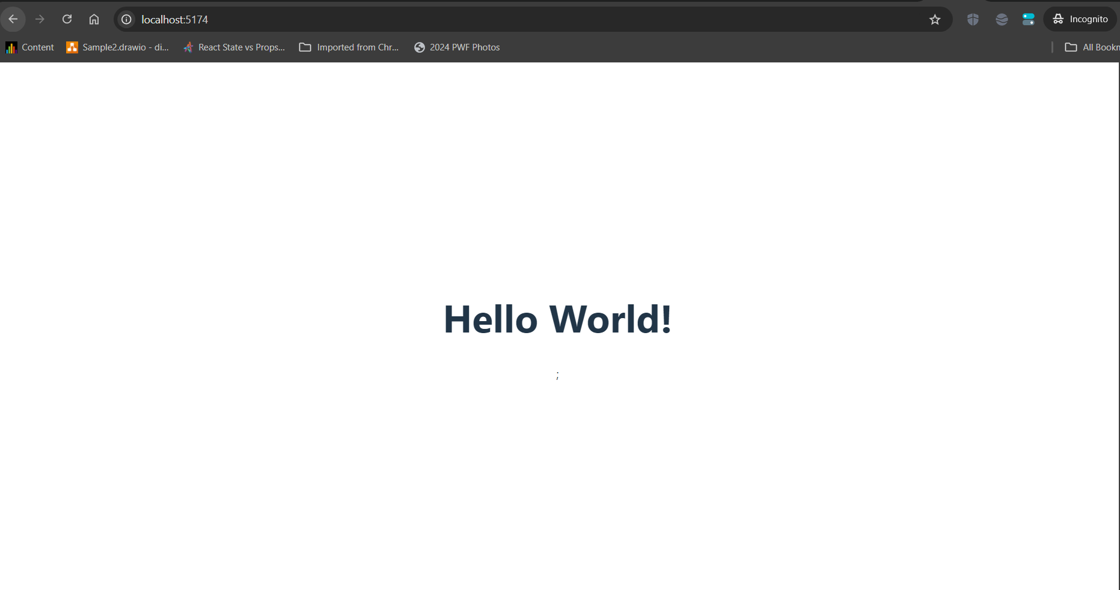
Output is as follows:

Slide 31
ReactDOM.render vs createRoot
Old Method
ReactDOM.render(<App />, rootElement);
New React 18 Method
const root = createRoot(rootElement);
root.render(<App />);
Advantages of createRoot
Better performance
Concurrent rendering
Automatic batching
Improved responsiveness

Slide 32
CLASSNAME IN REACT
Any element that has an HTML class attribute is using className for that property instead of class.
Since class is a reserved word in JavaScript, we have to use className to define the class attribute of an HTML element.
EXAMPLE I
Let’s create a function that returns an unordered list of ingredients dessert with a function called IngredientsList

Slide 33
Updated App.jsx
Modify the App.jsx in the existing application as follows i.e replace with the following code:
import React from "react";
import "./App.css";
function IngredientsList() {
return (
<div>
<h1>Ingredients</h1>
<p>Ingredients list</p>

Slide 34
Updated App.jsx contd.
<ul className="ingredients">
<li>1 cup unsalted butter</li>
<li>1 cup crunchy peanut butter</li>
<li>1 cup brown sugar</li>
<li>1 cup white sugar</li>
<li>2 eggs</li>
<li>2.5 cups all purpose flour</li>
<li>1 teaspoon baking powder</li>
<li>0.5 teaspoon salt</li>
</ul>
</div>
);
}
export default IngredientsList

Slide 35
Updated main.jsx
import { StrictMode } from "react";
import { createRoot } from "react-dom/client";
import "./index.css";
import IngredientsList from "./App.jsx";
createRoot(document.getElementById("root")).render(
<StrictMode>
<IngredientsList />
</StrictMode>
);

Slide 36
Updated App.css
Add the following code to the existing App.css to remove the list style.
ul li {
list-style: none;
}

Slide 37
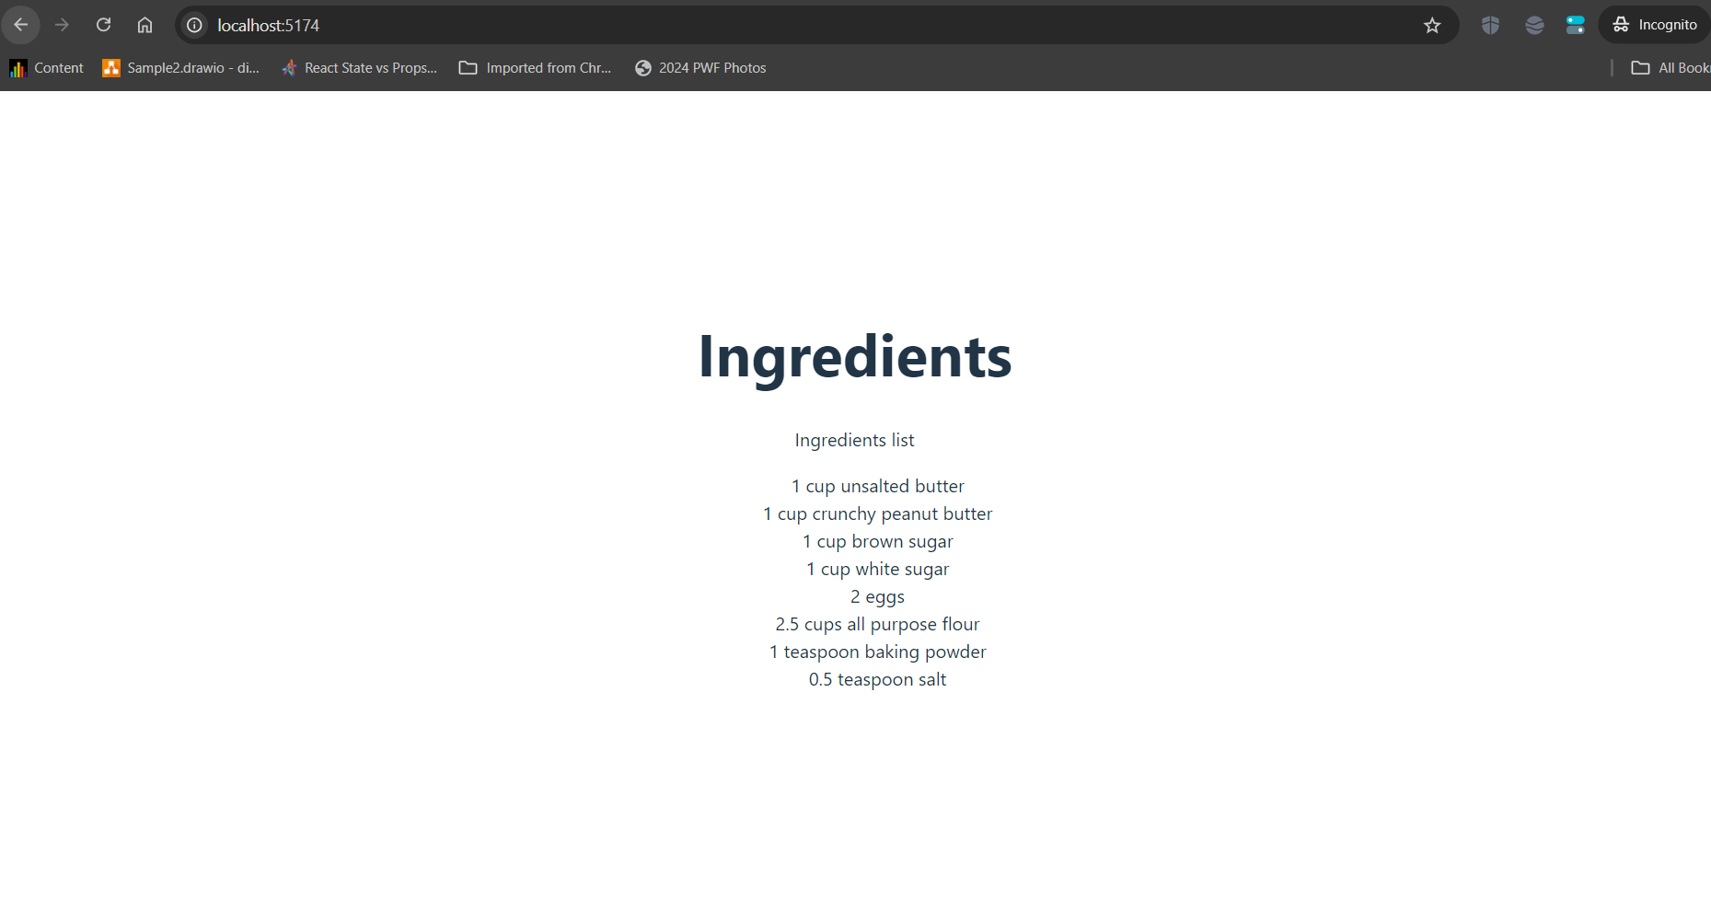

Slide 38
Rendering Lists with map()
Create the Items Array
code
const items = [
"1 cup unsalted butter",
"1 cup crunchy peanut butter",
"1 cup brown sugar",
"1 cup white sugar",
"2 eggs",
"2.5 cups all purpose flour",
"1 teaspoon baking powder",
"0.5 teaspoon salt"
];

Slide 39
Rendering Dynamically
Then we’ll adjust the IngredientsList component to map over these items, constructing a li for however many items are in the items array:
code
function IngredientsList() {
return (
<>
<div>
<h1>Ingredients</h1>
<p>Ingredients list</p>
<ul className="ingredients">
{items.map((ingredient, i) => (
<li key={i}>{ingredient}</li>
))}
</ul>
</div>
</>
);
}

Slide 40
Updated App.jsx file.
import React from "react";
import "./App.css";
const items = [
"1 cup unsalted butter",
"1 cup crunchy peanut butter",
"1 cup brown sugar",
"1 cup white sugar",
"2 eggs",
"2.5 cups all purpose flour",
"1 teaspoon baking powder",
"0.5 teaspoon salt",
];

Slide 41
Updated App.jsx contd.
function IngredientsList() {
return (
<div>
<h1>Ingredients</h1>
<p>Ingredients list</p>
<ul className="ingredients">
{items.map((ingredient, i) => (
<li key={i}>{ingredient}</li>
))}
</ul>
</div>
);
}
export default IngredientsList

Slide 42
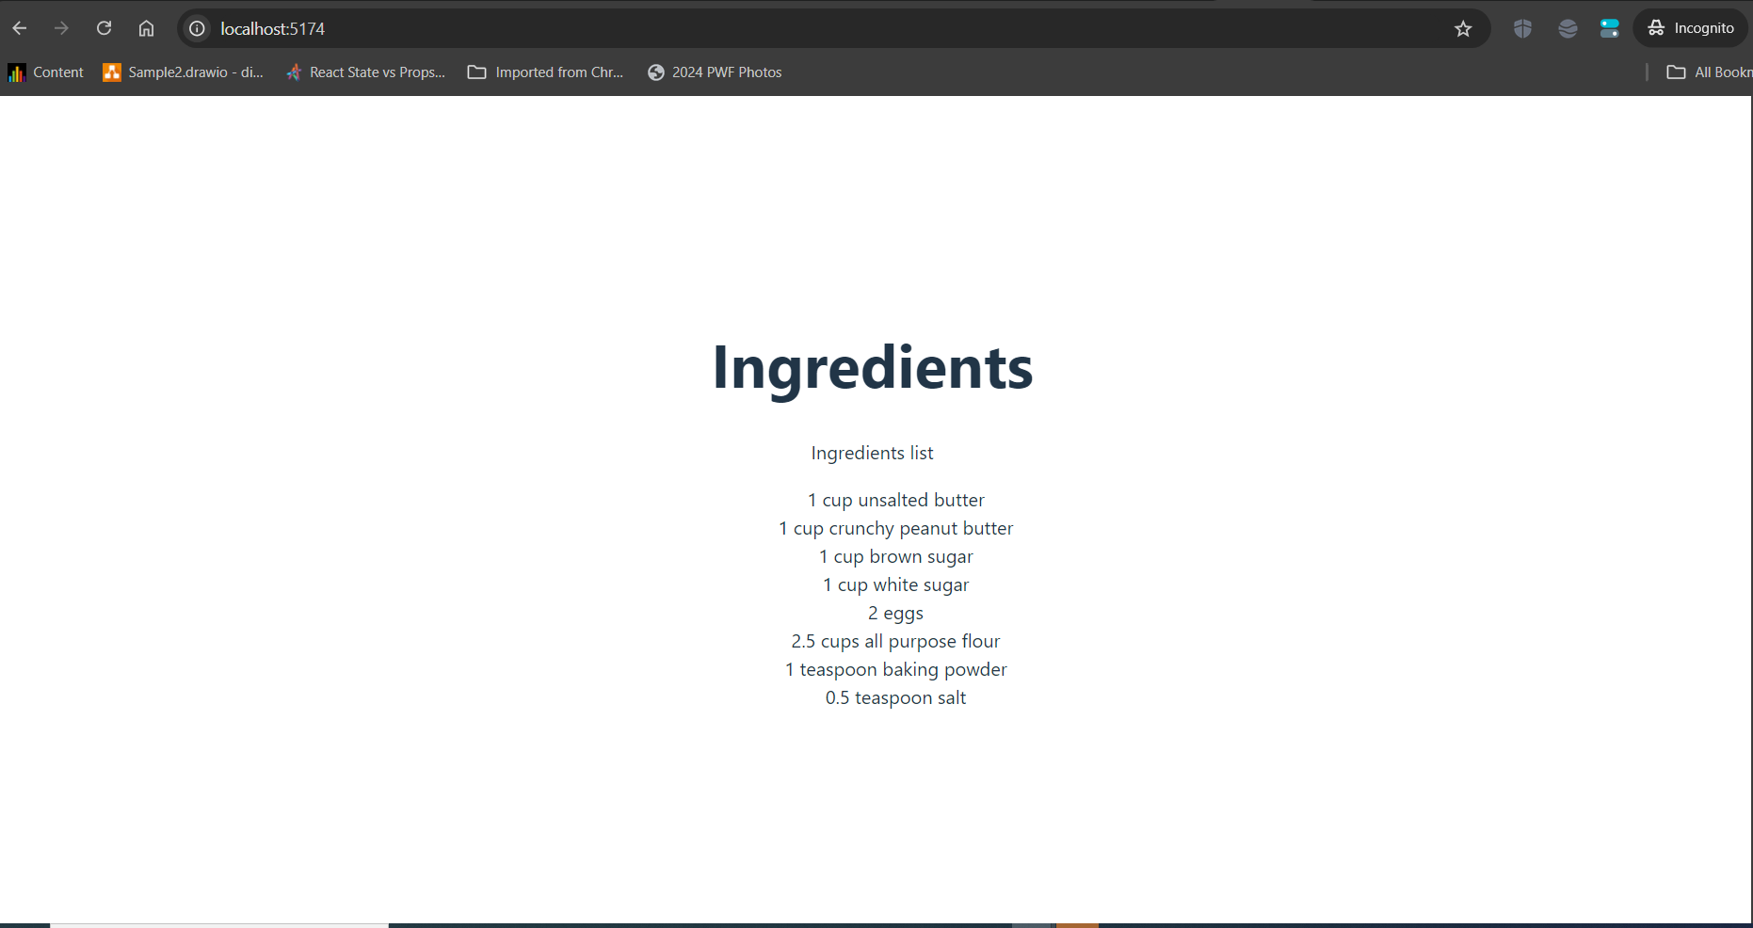
Output

Slide 43
Important Concepts
map() loops through arrays
key uniquely identifies list items
Creating our component this way will make the component more flexible.
Whether the items array is 1 item or 100 items long, the component will render each as a list item.

Slide 44
JSX (JavaScript XML)
JSX allows HTML inside JavaScript.
EXAMPLE I
const name = 'John Smith’;
const element = <h1>Hello, {name}</h1>;
ReactDOM.render(
element,
document.getElementById('root')
);
In the second line, we call the name variable inside a React element by putting it inside the curly brackets.
Meanwhile, the ReactDOM.render() function renders the React element on the Document Object Model (DOM) tree, describing the UI.

Slide 45
Updated App.jsx
React Component Example
import React from "react";
import "./App.css";
const HeroSection = () => {
const name = 'John Smith';
const element = <h1>Hello, {name}</h1>;
return(
<div>
{element}
</div>
)
}
export default HeroSection;

Slide 46
Updated main.jsx
import React, { StrictMode } from "react";
import { createRoot } from "react-dom/client";
import "./index.css";
import HeroSection from "./App.jsx"; // Ensure this file exists and is correctly //named
const root = createRoot(document.getElementById("root"));
root.render(
<StrictMode>
<HeroSection />
</StrictMode>
);

Slide 47
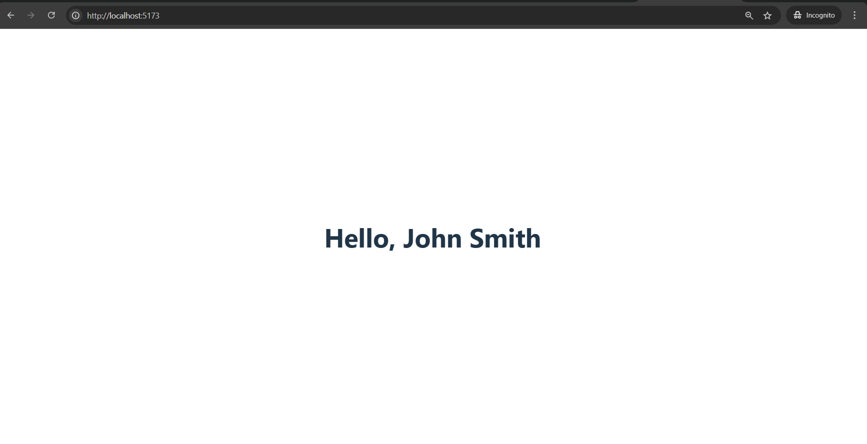

Slide 48
JSX Expressions
You can use JavaScript expressions inside {}
EXAMPLE II
const HeroSection = () => {
const a = 25;
const b = 75;
return (
<div>
<h1>{ a + b }</h1>
</div>
);
}

Slide 49
Updated App.jsx
import React from "react";
import "./App.css";
const HeroSection = () => {
const a = 25; const b = 75;
return (
<div>
<h1>{a + b}</h1>
</div>
);
}
export default HeroSection;

Slide 50
Updated main.jsx
import React, { StrictMode } from "react";
import { createRoot } from "react-dom/client";
import "./index.css";
import HeroSection from "./App.jsx"; // Ensure this file exists and is correctly named
const root = createRoot(document.getElementById("root"));
root.render(
<StrictMode>
<HeroSection />
</StrictMode>
);

Slide 51
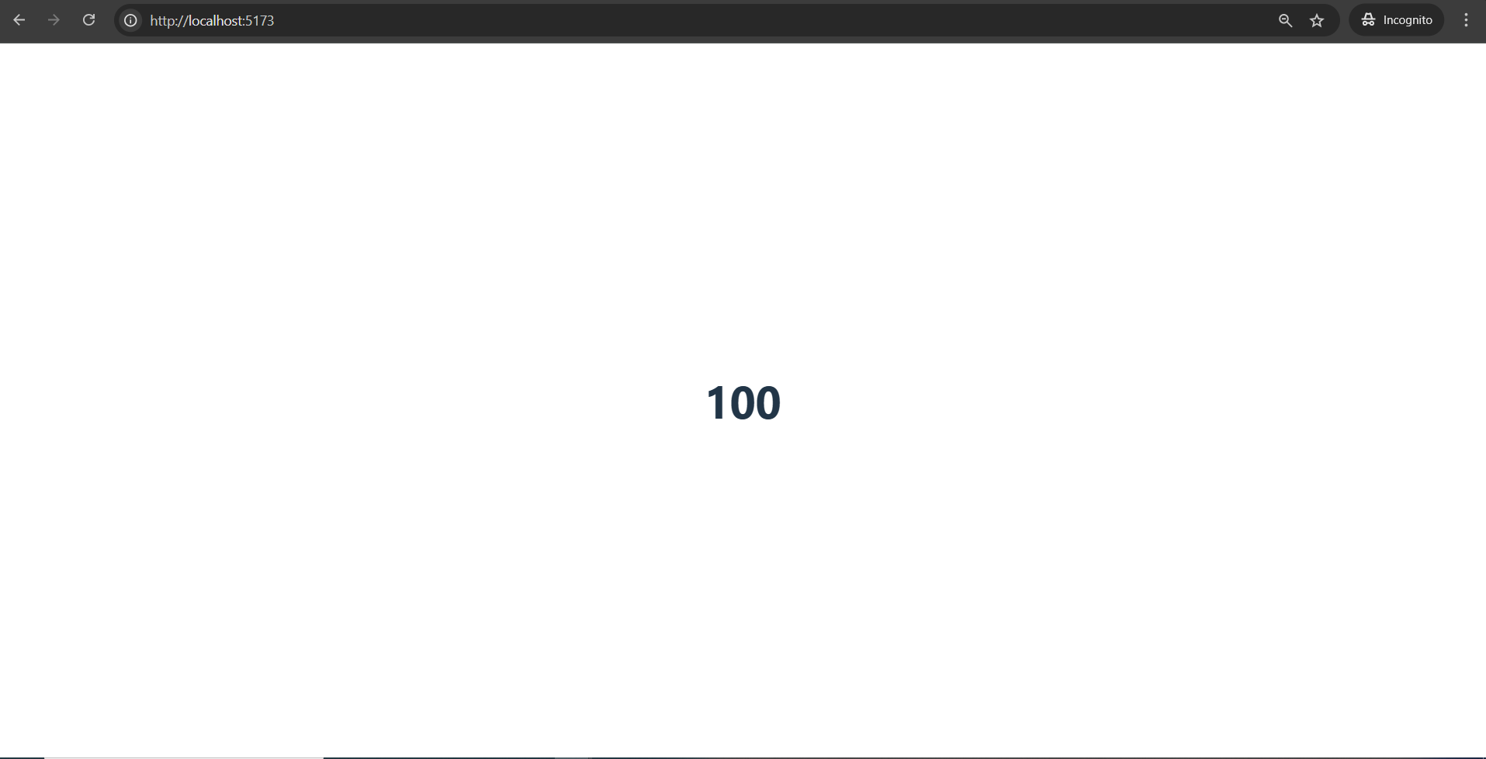

Slide 52
Virtual DOM
React uses a Virtual DOM for faster updates.
How it Works
React creates a lightweight copy of the DOM.
Changes are made in the Virtual DOM first.
React compares Virtual DOM with real DOM.
Only changed elements are updated.
This improves performance.

Slide 53
One-Way Data Binding
Data flows: (parent → child):
Benefits
Easier debugging
Better control
Easier maintenance

Slide 54
React Extensions
React supports additional technologies like:
Redux
Flux
React Native
React Native
Used for building:
iOS apps
Android apps
using shared React code.

Slide 55
Summary
React:
Builds modern user interfaces
Uses reusable components
Uses JSX for cleaner code
Uses Virtual DOM for speed
Supports modern rendering with createRoot
Works well for web and mobile applications

